Slide 1
Threads & Concurrency Lecture 2 Thread Libraries
David Liu
Fall 2021, Spring 2022

Slide 2
Learning Outcomes
Understand Pthreads, Window Threads, and Java Threads

Slide 3
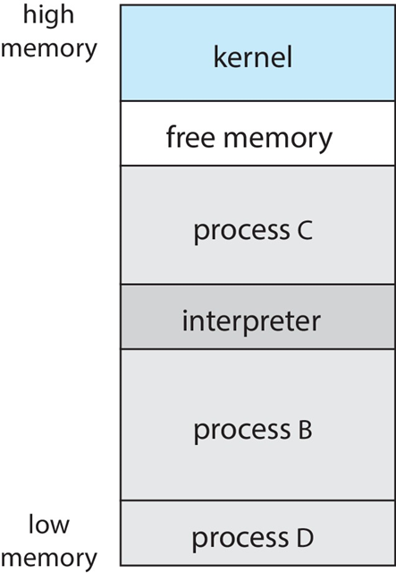
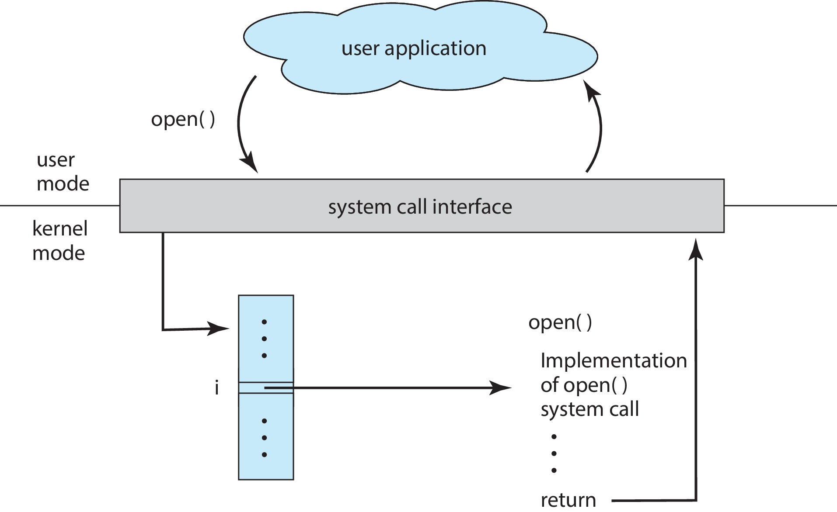
User Space vs Kernel-level Thread Library
User Space library
Code and data structures in user space, no system call
Kernel-level library
Code and data in kernel space, API function call → system call

Slide 4
Asynchronous vs Synchronous Threads
Asynchronous
Parent and child execute concurrently and independently
Synchronous
Parent wait for all its children to terminates before it resumes

Slide 5
Pthreads Implementation
POSIX standard is just a specification
API specifies behavior only

Slide 6
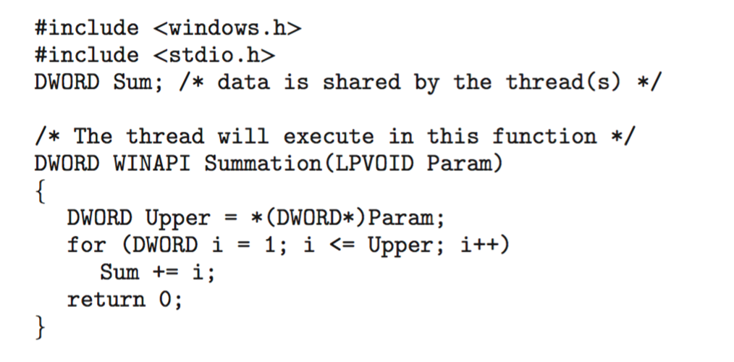
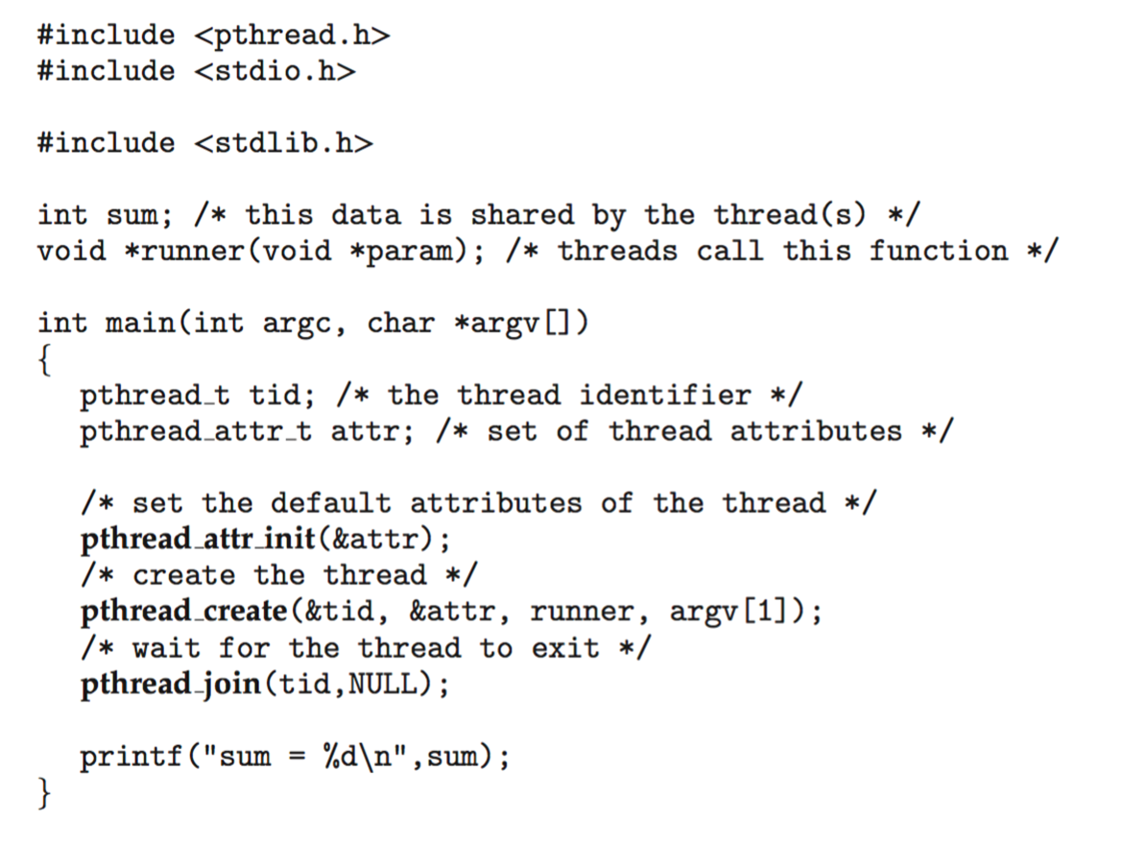
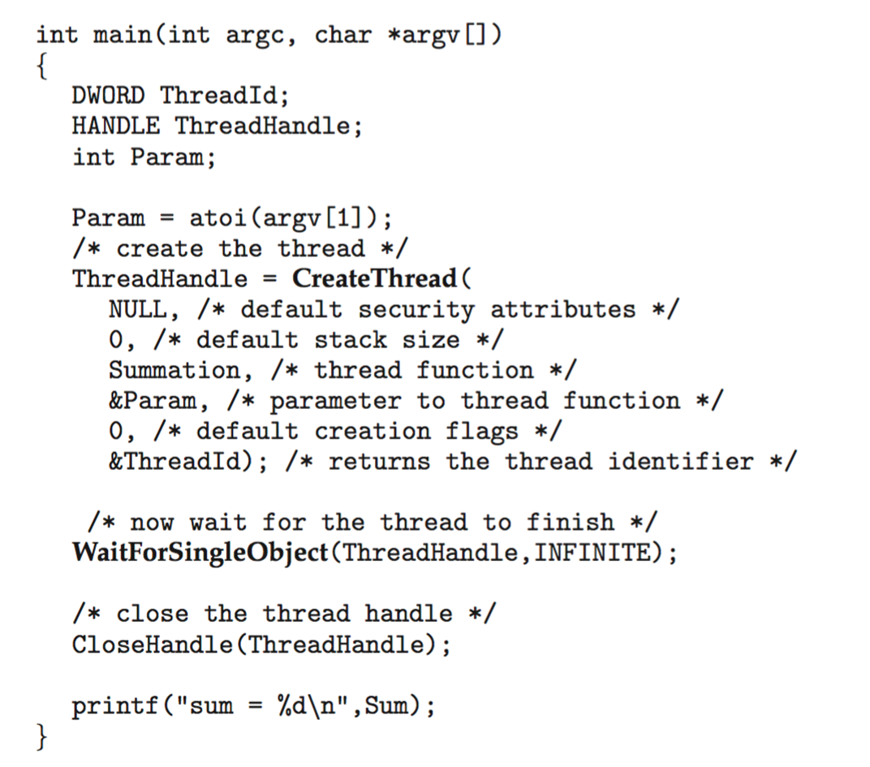
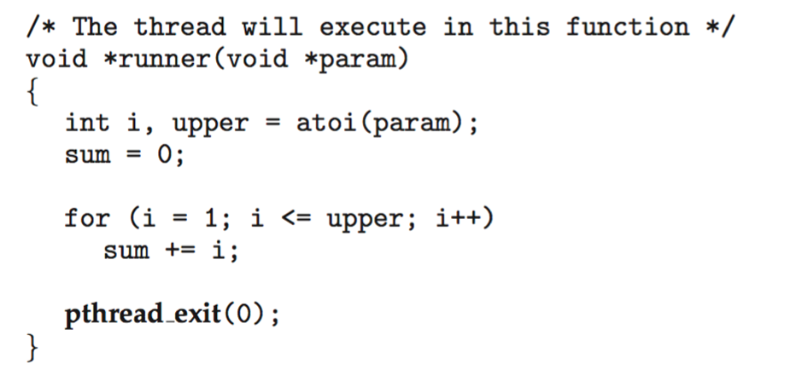
Pthreads vs Window Threads

Slide 7
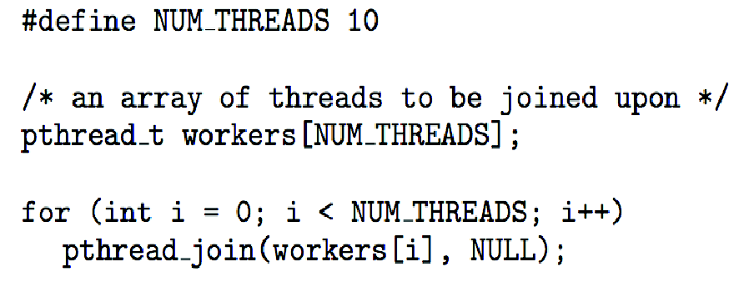
Pthreads Joining

Slide 8
Question
Assume that we want to divide summation of an array of size N equally to M threads for partial summation
How does a thread know which the block number n: n = 0, …, N – 1
What are the begin and end indices for nth thread?
How does a thread access the array?
How does the main thread calculate the total sum?

Slide 9
Java Threads
Java threads are managed by the JVM
Typically implemented using the threads model provided by underlying OS

Slide 10
Java Threads Creation
Two Ways
Extend Thread class
Implementing the Runnable interface

Slide 11
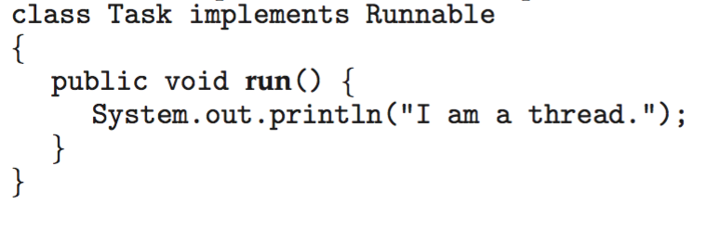
Java Threads with Runnable Interface
Implementing Runnable interface:

Slide 12
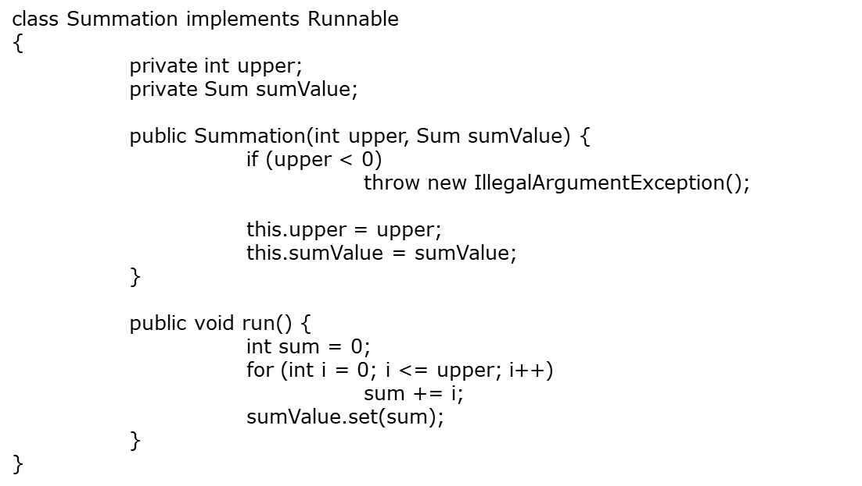
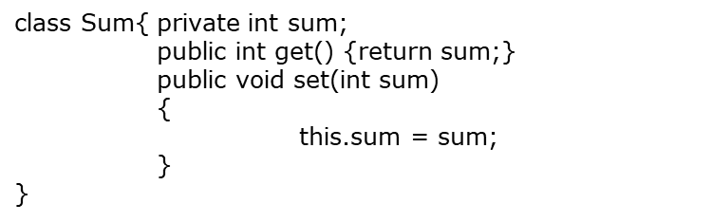
Java Thread Example: Sum
Class Sum:
Thread Class Summation:

Slide 13
Java Thread Example: Sum
Class Driver:
public class Driver
{ public static void main(String[] args) {
if (args.length != 1) { System.err.println("Usage Driver <integer>"); System.exit(0);
}
Sum sumObject = new Sum();
int upper = Integer.parseInt(args[0]);
Thread worker = new Thread(new Summation(upper, sumObject)); worker.start();
try {
worker.join();
} catch (InterruptedException ie) { } System.out.println("The sum of " + upper + " is " + sumObject.get());
}
}

Slide 14
Questions
Assume that we want to divide summation of an array of size N equally to M threads for partial summation
How does a thread access the array? How about the number of threads or the block size?
How does a thread know which the block number n: n = 0, …, M – 1
What are the begin and end indices for nth thread?
How does the main thread calculate the total sum?

